Slide 1

Enhancing SQL Injection Detection: A Comparative
Study of SVM, Random Forest, and Hybrid Models
Project Final Presentation
Vaishnavi 200953025 CCE
Adithya Rao Kalathur
200953015
CCE
Under the guidance of
Dr. Balachandra
Professor Department of I & CT
May 20, 2024
1/100

Slide 2
Presentation Outline
Introduction
Literature Survey / Background Theory Problem Definition
Objectives Methodology
What is SQL Injection
Exploiting SQLI Vulnerability
SQL Injection Detection using ML Algorithms
Results
SQL Injection Prevention
Conclusion
Future Scope
Scope
Paper to be communicated
References
2/ 100

Slide 3
Introduction
SQL Injection (SQLi) attacks persist as significant threats to web applications and databases.
These attacks exploit vulnerabilities in input fields to compromise data integrity by manipulating SQL queries.
Consequences may include data leaks, unauthorized access, or data manipulation.
Detecting and mitigating SQL Injection attempts are crucial for maintaining the security and integrity of web-based systems.
Machine Learning (ML) techniques automate the analysis of vast datasets, enhancing detection capabilities.
3/100

Slide 4
Introduction(continued)
SVM, Random Forest, and hybrid models are investigated for their effectiveness in identifying SQL Injection attempts.
Performance metrics like accuracy, precision, recall, and F1-score are analyzed to gauge model efficacy.
Insights from this study will aid in developing robust detection systems to thwart evolving SQL Injection attack vectors.
Organizations can leverage these findings to fortify systems against SQL Injection threats, safeguarding critical data assets and user privacy.
The study contributes to refining ML-based security mechanisms, fostering a proactive and adaptive cybersecurity approach.
4/100

Slide 5
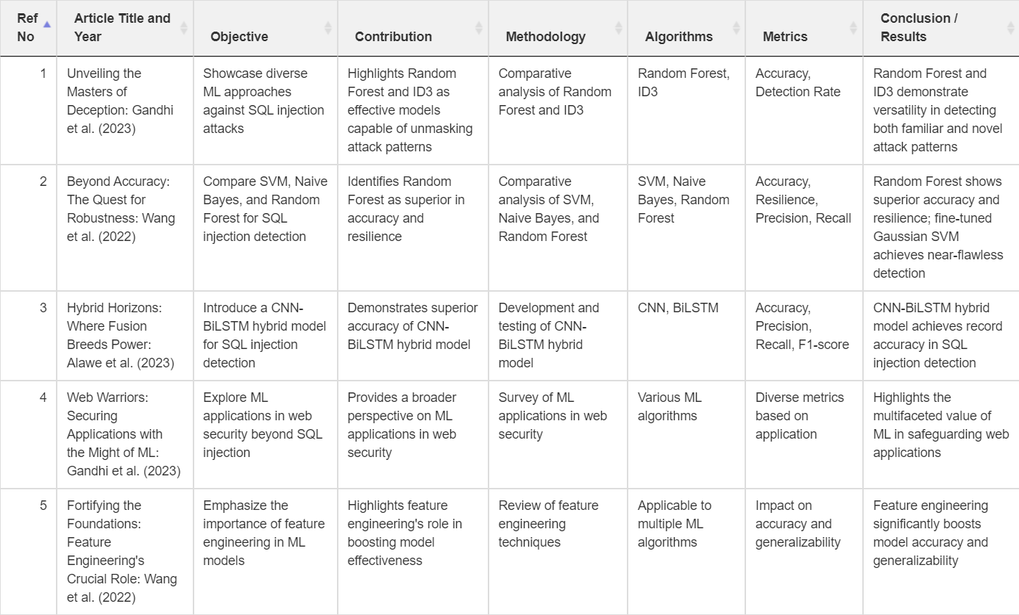
Literature Survey/ Background Theory
Table: Literature Survey (Part 1)
5/100

Slide 6
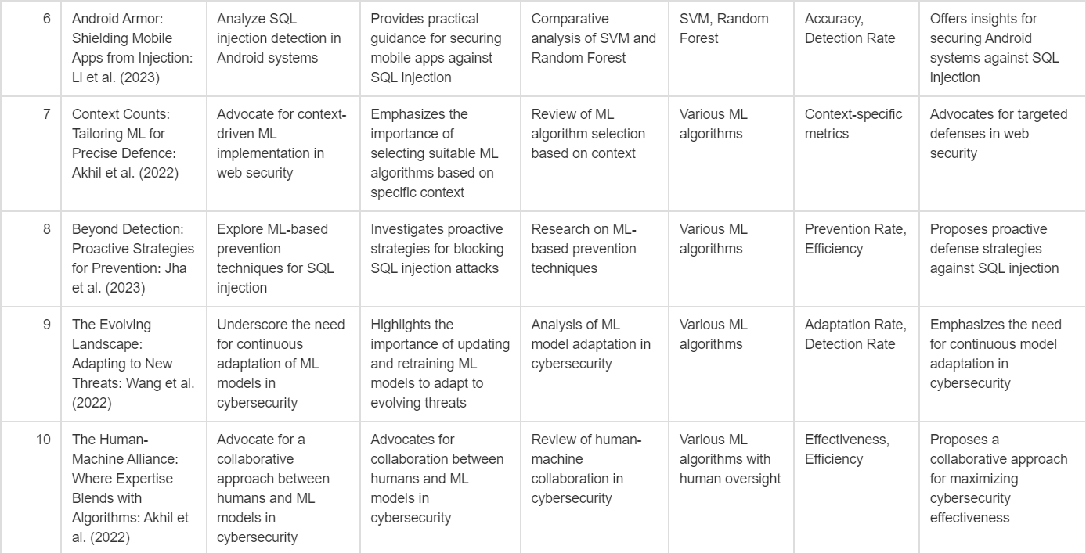
Literature Survey (continued)
Table: Literature Survey (Part 2)
6/100

Slide 7
Problem Definition
Persistent Threat of SQL Injection Attacks
SQL injection attacks remain a significant cybersecurity concern for web applications.
Conventional rule-based defence mechanisms struggle to keep pace with evolving attack tactics.
Need for Advanced Detection Methods
Cyber adversaries continuously adapt and innovate, circumventing traditional security measures.
Increasing interest in exploring machine learning techniques to bolster detection capabilities.
7/100

Slide 8
Problem Definition(continued)
Research Focus: Machine Learning for SQL Injection Detection
Examination of Support Vector Machines (SVM), Random Forest, and hybrid models.
Evaluation of diverse performance metrics: accuracy, precision, recall, F1-score, and AUC.
Key Challenge
Addressing the dynamic nature of SQL injection attack vectors.
Developing robust detection systems capable of adapting to emerging threats.
8/100

Slide 9
Objectives
Objective 1:Exploiting SQLI Vulnerability
Mimic a SQL injection attack.
Gain unauthorized access to a web application’s database.
Highlight security threats.
Showcase ease of SQL injection attacks.
Emphasize negative effects.
Illustrate practical ramifications.
Objective 2: SVM Model for SQL Injection Detection
Conduct literature review on SVM-based intrusion detection for SQL injection.
Preprocess suitable datasets for SVM model training.
Design robust SVM architecture and optimize hyperparameters. Train SVM model using cross-validation.
Evaluate performance using metrics like Accuracy, Precision, Recall, F1 score.
Fine-tune SVM model based on evaluation results.
9/100

Slide 10
Objectives (continued)
Objective 3: Random Forest for SQL Injection Detection
Conduct literature review on Random Forest in intrusion detection, focusing on SQL injection.
Expand dataset to include a broader range of SQL injection attack patterns.
Design and implement Random Forest model tailored for SQL injection detection.
Train and cross-validate Random Forest model, evaluating performance.
Objective 4: Hybrid SVM-Random Forest Model
Explore literature on hybrid SVM-Random Forest models for intrusion detection.
Harmonize datasets for compatibility between SVM and Random Forest. Design seamless hybrid architecture integrating SVM and Random Forest.
Train hybrid model and compare performance with standalone SVM and Random Forest.
Define specific evaluation metrics.
Fine-tune hyperparameters and architecture for optimal detection accuracy.
10/100

Slide 11
Methodology
Objective 1: Exploiting SQLI Vulnerability
Create carefully crafted SQL queries.
Execute generated SQL queries.
Utilize SQL query injection techniques.
Employ input field manipulation strategies.
Test for vulnerabilities in web application.
Analyze response to identify potential entry points.
Objective 2: Detection of SQL Injection using SVM ML Model
Literature Review
Dataset Selection and Preparation
Model Design and Implementation
Training and Validation Evaluation
Metrics
Fine-Tuning and Optimization
11/100

Slide 12
Methodology (continued)
Objective 3: Assess Random Forest’s Aptitude for SQL Injection Detection
Literature Review on Random Forest in Intrusion Detection
Dataset Expansion for Comprehensive Analysis
Design and Implementation of Tailored Random Forest Model
Training and Cross-Validation for Performance Evaluation
Objective 4: Detection of SQL Injection using Hybrid Model of SVM and Random Forest ML Models
Literature Review on Hybrid Models
Dataset Harmonization
Hybrid Model Design and Implementation
Training and Validation
Evaluation Metrics for Hybrid Model
Fine-Tuning and Optimization of Hybrid Model
12/100

Slide 13
Methodology (continued)
Stages of Methodology:
Data Preprocessing: Cleansing, feature engineering, imputation, categorical to numerical conversion
Model Training: Hyperparameter tuning for SVM, Random Forest, Hybrid models
Model Evaluation: Using accuracy, precision, recall, F1-score
Analysis: Statistical significance testing, feature importance analysis
13/100

Slide 14
Methodology (continued)
Key Assumptions:
Dataset accurately represents SQLi scenarios
Preprocessing techniques improve data quality
Hyperparameter tuning enhances model performance
Evaluation metrics reflect true model performance
Components Used:
Dataset: Modified_SQL_Dataset.csv, SQLi_Dataset.csv, Payload_Full_Dataset.csv, Clean_SQL_Dataset.csv.
Models: SVM, Random Forest, Hybrid Model
Evaluation Metrics: Accuracy, Precision, Recall, F1-score
Libraries: Pandas, Scikit-learn, NLTK, Matplotlib, Seaborn
14/100

Slide 15
What is SQL Injection
Vulnerability that consists of an attacker interfering with the SQL queries that an application makes to a database.
15/100

Slide 16
What is SQL Injection
Impact of SQL Injection Attacks
Unauthorized access to sensitive data
Confidentiality – SQLi can be used to view sensitive information, such as application usernames and passwords
Integrity – SQLi can be used to alter data in the database
Availability – SQLi can be used to delete data in the database
Remote code execution on the operating system
16/100

Slide 17
What is SQL Injection
Types of SQL Injection
17/100

Slide 18
What is SQL Injection
In-Band SQL Injection
In-band SQLi occurs when the attacker uses the same communication channel to both launch the attack and gather the result of the attack
Easier to exploit than other categories of SQLi
Two common types of in-band SQLi
Retrieved data is presented directly in the application web page
Error-based SQLi
Union-based SQLi
18/100

Slide 19
What is SQL Injection
Error-Based SQLi
Error-based SQLi is an in-band SQLi technique that forces the database to generate an error, giving the attacker information upon which to refine their injection.
Example:
Input:
Output:
19/100

Slide 20
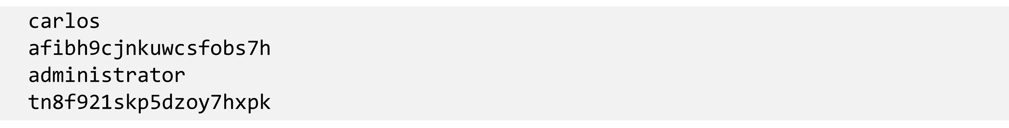
What is SQL Injection
Union-Based SQLi
Union-based SQLI is an in-band SQLi technique that leverages the UNION SQL operator to combine the results of two queries into a single result set
Example:
Input:
Output:
20/100

Slide 21
What is SQL Injection
Inferential (Blind) SQL Injection
SQLi vulnerability where there is no actual transfer of data via the web application
Just as dangerous as in-band SQL injection
Takes longer to exploit than in-band SQL injection
Two common types of blind SQLi
Attacker able to reconstruct the information by sending particular requests and observing the resulting behavior of the DB Server.
Boolean-based SQLi
Time-based SQLi
21/100

Slide 22
What is SQL Injection
Boolean-Based Blind SQLi
Boolean-based SQLi is a blind SQLi technique that uses Boolean conditions to return a different result depending on whether the query returns a TRUE or FALSE result.
22/100

Slide 23
What is SQL Injection
Boolean-Based Blind SQLi
Example URL:
Backend Query:
Payload #1 (False):
Backend Query:
23/100

Slide 24
What is SQL Injection
Boolean-Based Blind SQLi
Payload #2 (True):
Backend Query:
Users Table:
Payload:
24/100

Slide 25
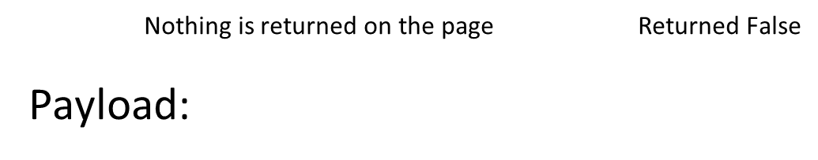
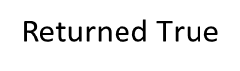
What is SQL Injection
Boolean-Based Blind SQLi
Backend Query:
‘s’ is NOT the first character of the hashed password
Backend Query:
25/100

Slide 26
What is SQL Injection
Time-Based Blind SQLi
Time-based SQLi is a blind SQLi technique that relies on the database pausing for a specified amount of time, then returning the results, indicating a successful SQL query execution.
Example Query:
If the first character of the administrator’s hashed password is an ‘a’, wait for 10 seconds.
→ response takes 10 seconds → first letter is ‘a’
→ response doesn’t take 10 seconds → first letter is not ‘a’
26/100

Slide 27
What is SQL Injection
Out-of-Band (OAST) SQLi
Vulnerability that consists of triggering an out-of-band network connection to a system that you control.
Not common
A variety of protocols can be used (ex. DNS, HTTP)
Example Payload:
27/100

Slide 28
Exploiting SQLI Vulnerability
SQL Injection attack without using any Tools
Setting up of Metasploitable
28/100

Slide 29
Exploiting SQLI Vulnerability(Continued)
2
3
5
29/100

Slide 30
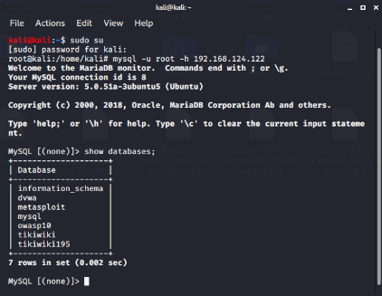
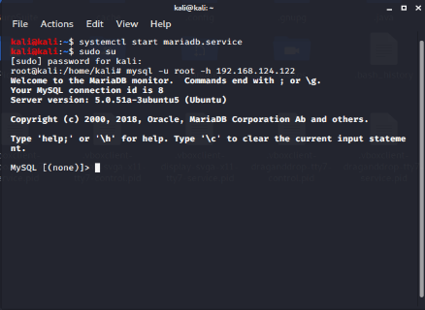
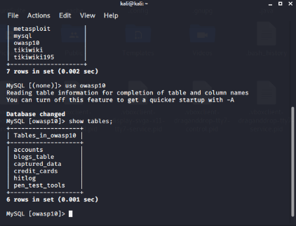
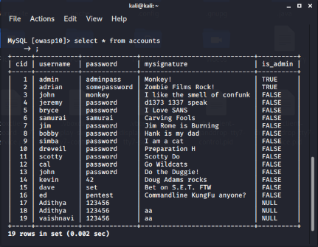
Exploiting SQLI Vulnerability(Continued)
Using IP address or inet addr to access the database
2
3
5
30/100

Slide 31
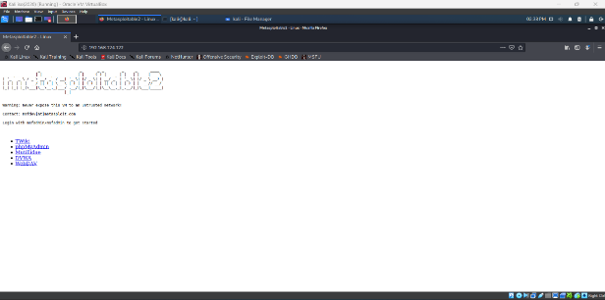
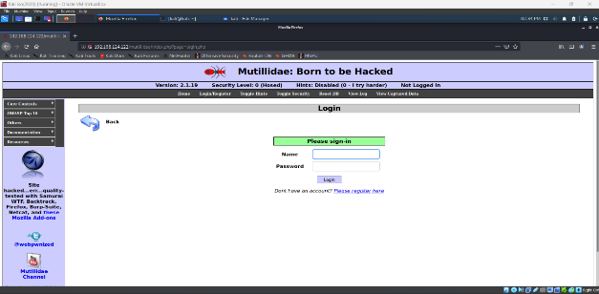
Exploiting SQLI Vulnerability(Continued)
Discovering SQL Injection in POST
2
3
5
31/100

Slide 32
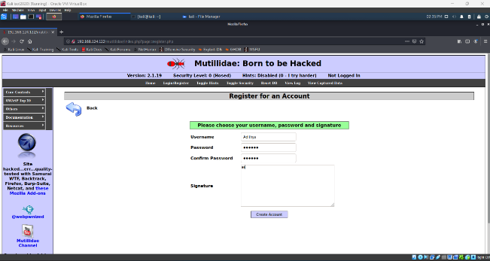
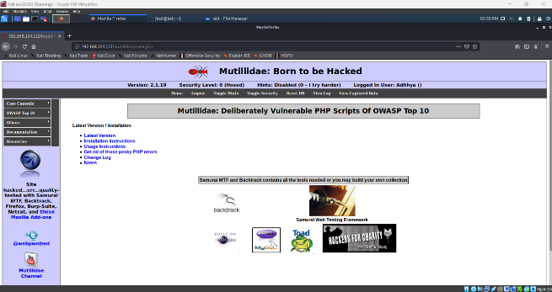
Exploiting SQLI Vulnerability(Continued)
2
3
5
32/100

Slide 33
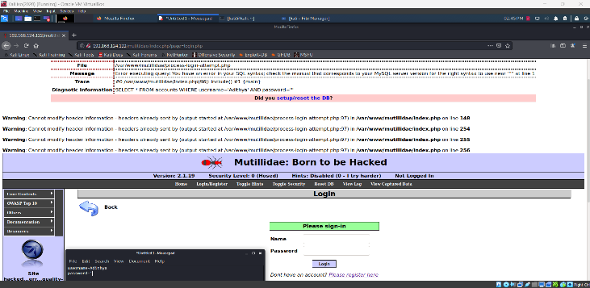
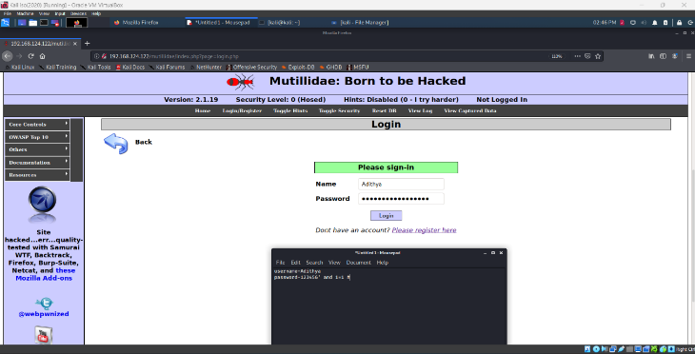
Exploiting SQLI Vulnerability(Continued)
2
3
5
33/100

Slide 34
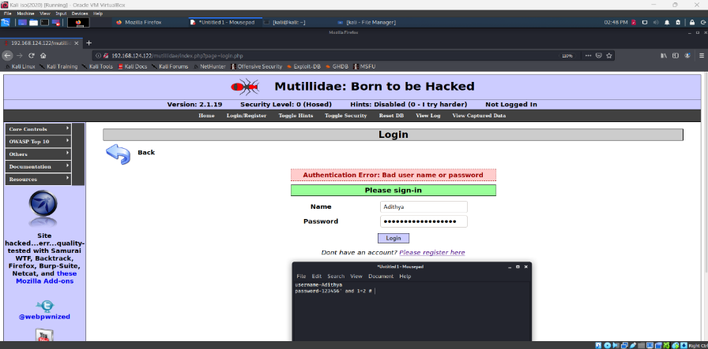
Exploiting SQLI Vulnerability(Continued)
2
3
5
34/100

Slide 35
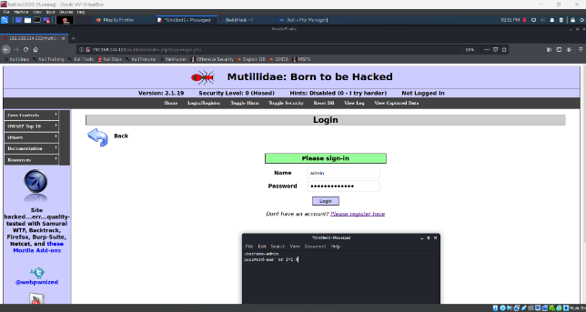
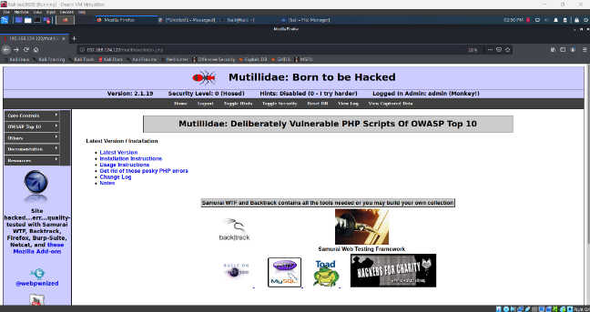
Exploiting SQLI Vulnerability(Continued)
Bypassing login pages using SQL Injection
2
3
5
35/100

Slide 36
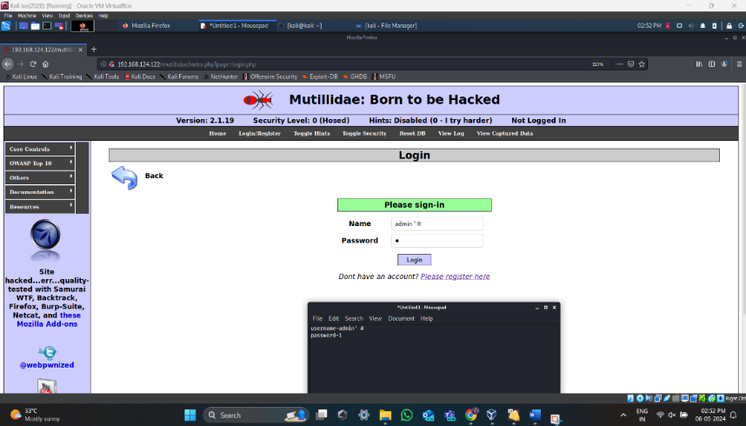
Exploiting SQLI Vulnerability(Continued)
2
3
5
36/100

Slide 37
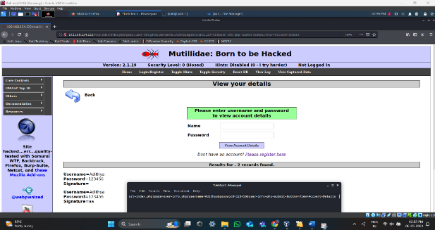
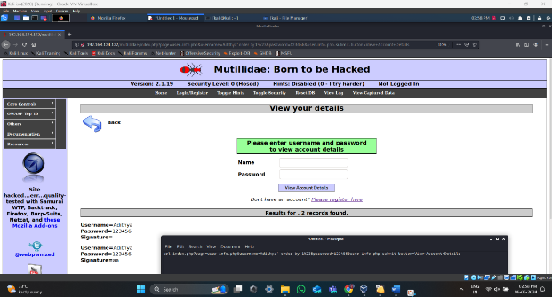
Exploiting SQLI Vulnerability(Continued)
Discovering SQL Injection in GET
2
3
5
37/100

Slide 38
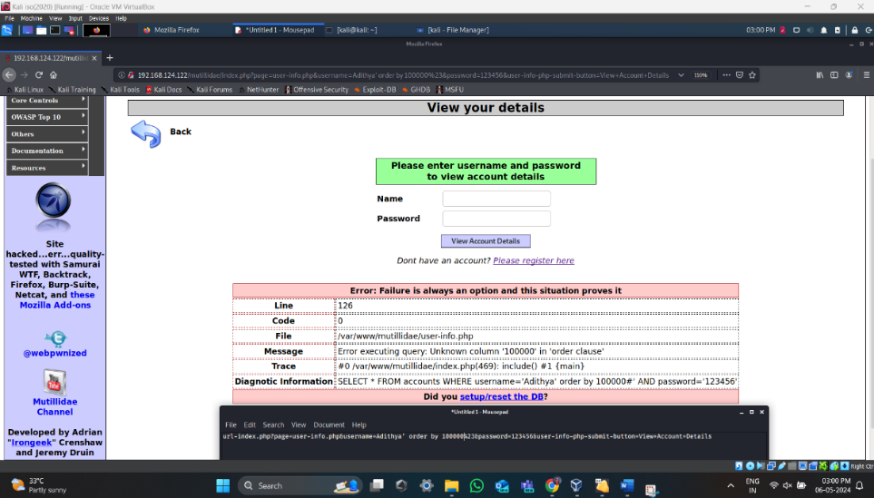
Exploiting SQLI Vulnerability(Continued)
2
3
5
38/100

Slide 39
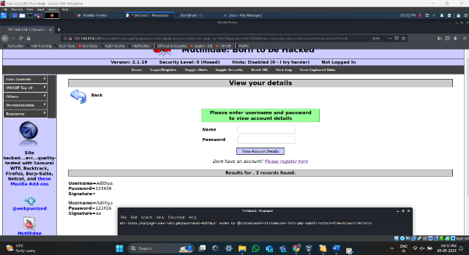
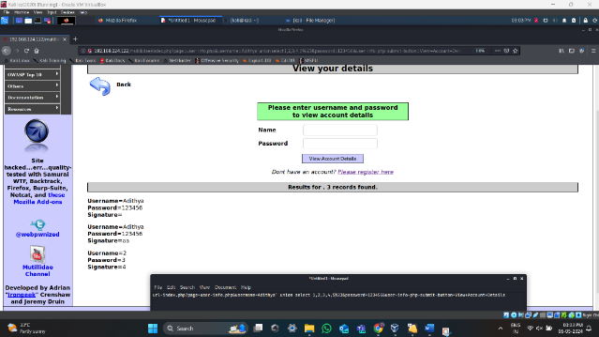
Exploiting SQLI Vulnerability(Continued)
Reading Databases information
2
3
5
39/ 40

Slide 40
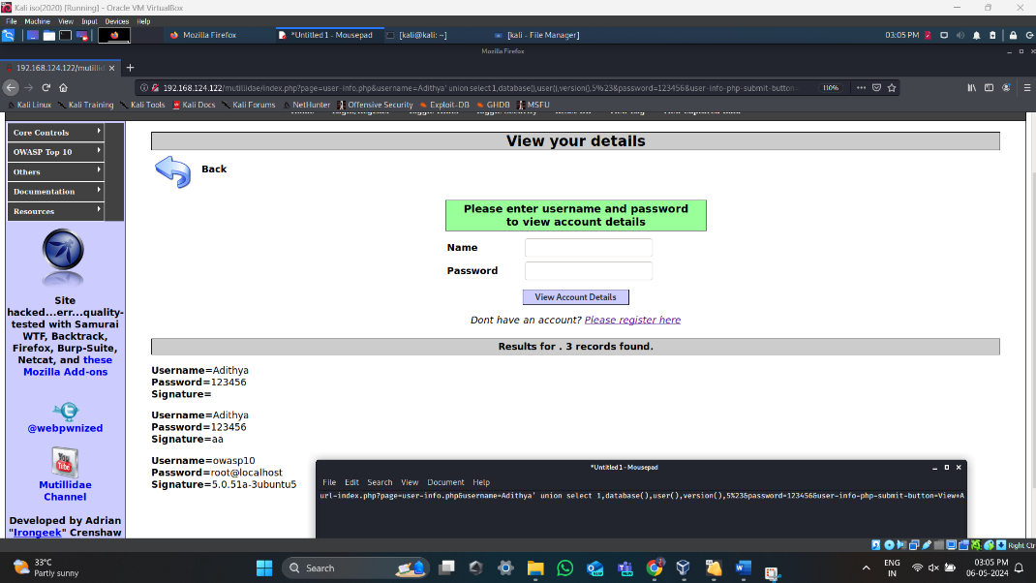
Exploiting SQLI Vulnerability(Continued)
2
3
5
40/100

Slide 41
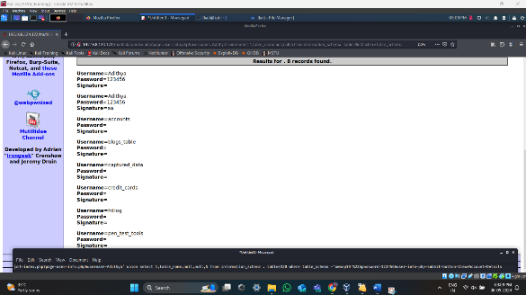
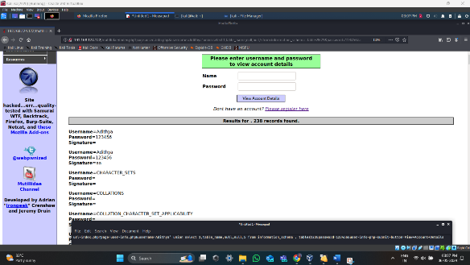
Exploiting SQLI Vulnerability(Continued)
Discovering Database Tables
2
3
5
41/100

Slide 42
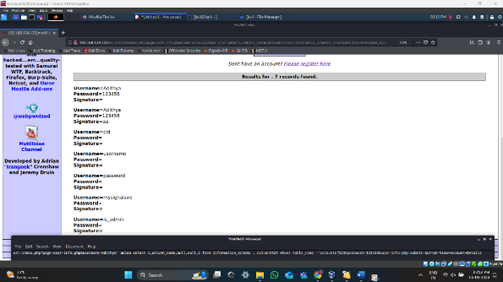
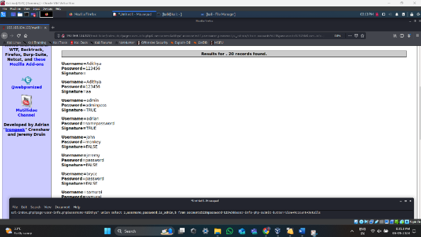
Exploiting SQLI Vulnerability(Continued)
Extracting sensitive data from Databases
2
3
5
42/100

Slide 43
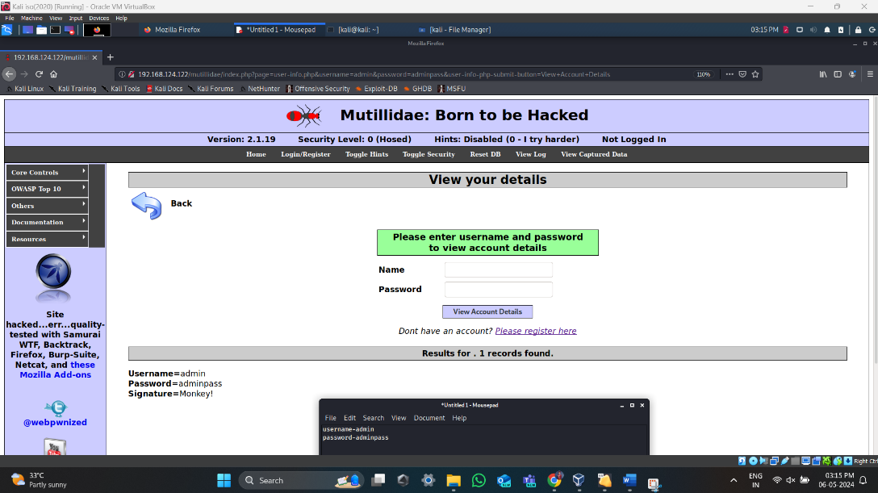
Exploiting SQLI Vulnerability(Continued)
2
3
5
43/100

Slide 44
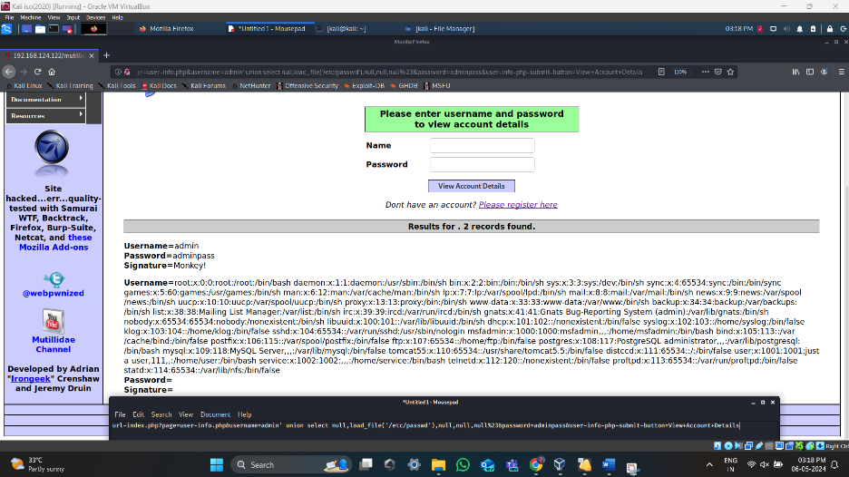
Exploiting SQLI Vulnerability(Continued)
Reading and writing files on the server
Reading
2
3
5
44/100

Slide 45
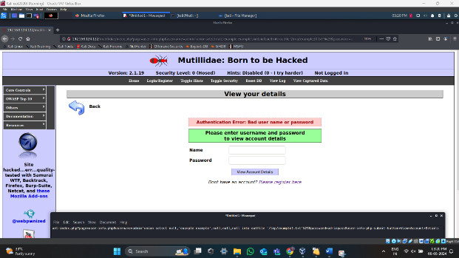
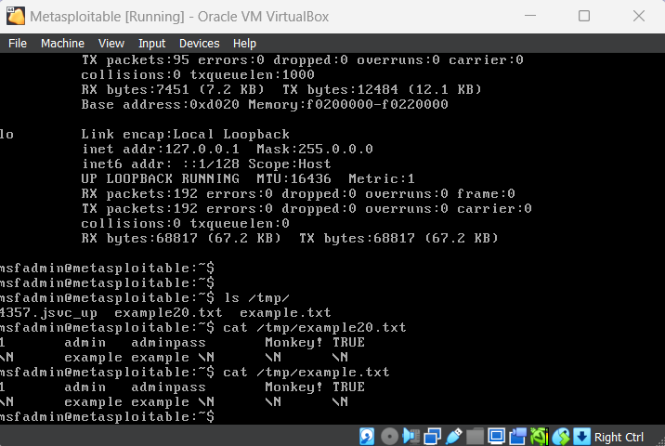
Exploiting SQLI Vulnerability(Continued)
Writing
2
3
5
45/100

Slide 46
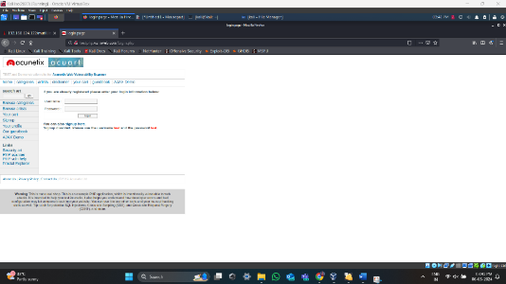
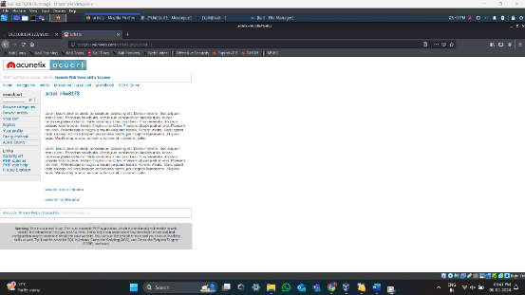
Exploiting SQLI Vulnerability(Continued)
SQL Injection attack using SQL Map Tool
Finding out the website and finding the required url to conduct SQL Injection attack.
2
3
5
46/100

Slide 47
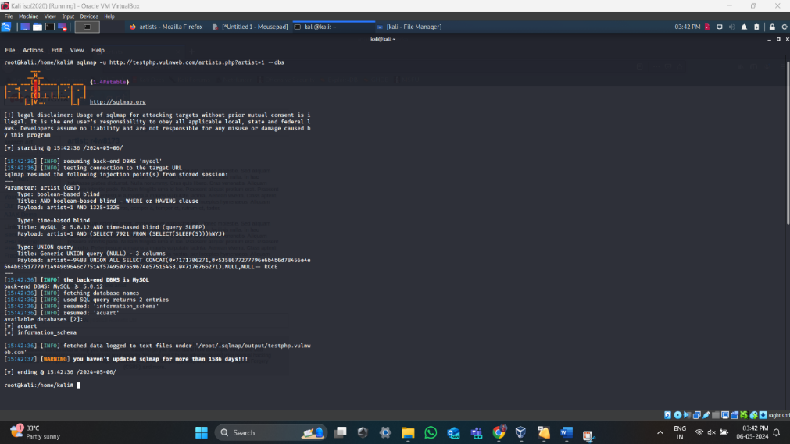
Exploiting SQLI Vulnerability(Continued)
Open a terminal in Kali linux and paste the command - sqlmap -u http://testphp.vulnweb.com/artists.php?artist=1 --dbs to show the database.
2
3
5
47/100

Slide 48
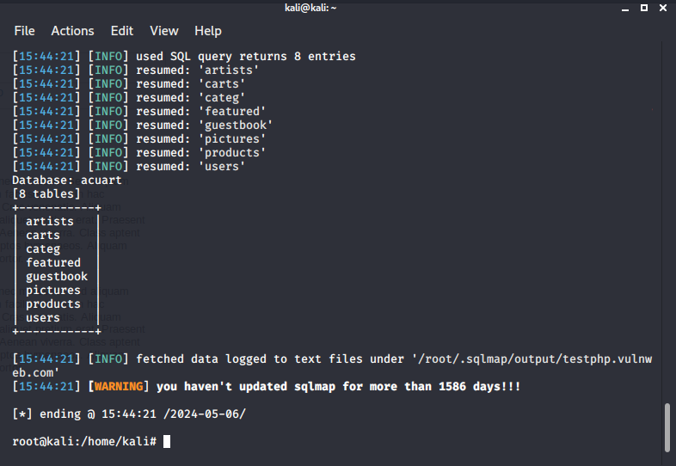
Exploiting SQLI Vulnerability(Continued)
Choose a database from the list of databases and use the following command - sqlmap -u http://testphp.vulnweb.com/artists.php?artist=1 -D acuart –tables to show the tables in that database
2
3
5
48/100

Slide 49
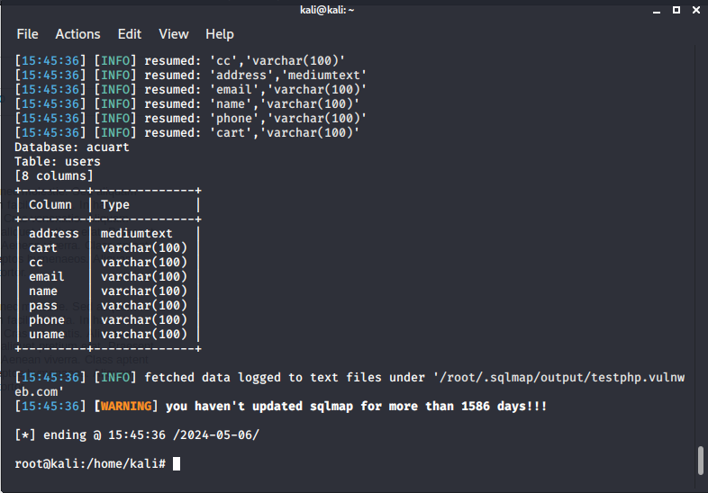
Exploiting SQLI Vulnerability(Continued)
Now Choose a Table from the list of Tables and use the following command - sqlmap -u http://testphp.vulnweb.com/artists.php?artist=1 -D acuart -T users –columns to show the columns and the type of columns in that table.
2
3
5
49/100

Slide 50
Exploiting SQLI Vulnerability(Continued)
Now we can use the commands-
sqlmap -u http://testphp.vulnweb.com/artists.php?artist=1 -D acuart -T users -C uname –dump
sqlmap -u http://testphp.vulnweb.com/artists.php?artist=1 -D acuart -T users -C pass –dump
sqlmap -u http://testphp.vulnweb.com/artists.php?artist=1 -D acuart -T users -C email –dump
To read all the username password and email from that table in the database
2
3
5
50/100

Slide 51
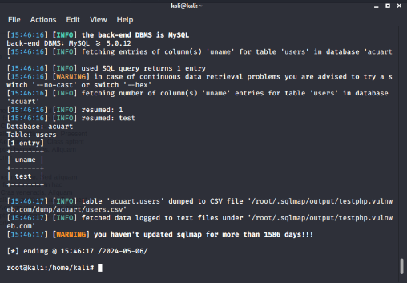
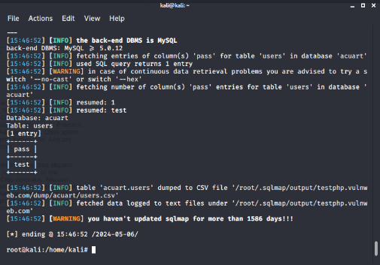
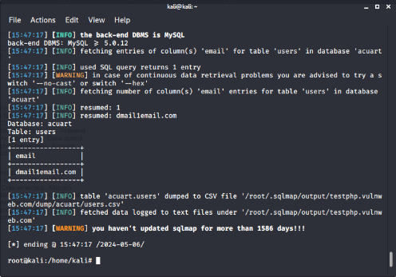
Exploiting SQLI Vulnerability(Continued)
2
3
5
51/100

Slide 52
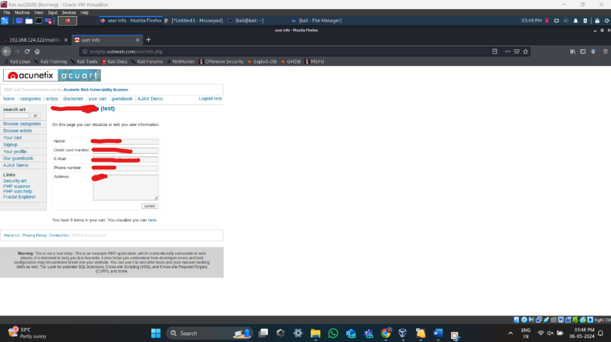
Exploiting SQLI Vulnerability(Continued)
Now we can use this data to gain access to the website
2
3
5
52/100

Slide 53
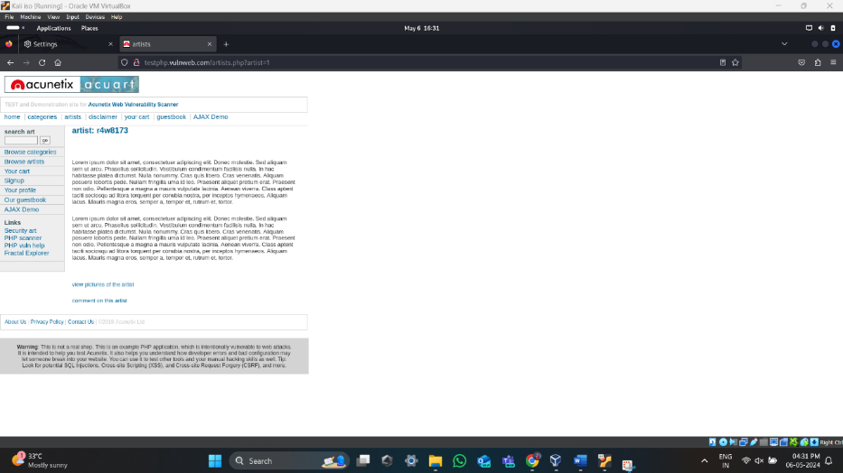
Exploiting SQLI Vulnerability(Continued)
SQL Injection attack using J SQL Tool
Finding the website url for testing sql injection attack
2
3
5
53/100

Slide 54
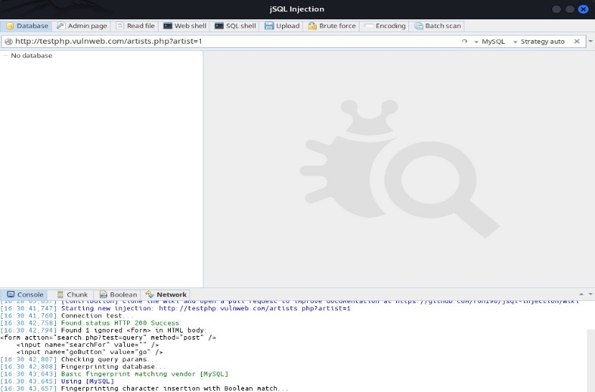
Exploiting SQLI Vulnerability(Continued)
Paste the website url in jsql tool and press run
2
3
5
54/100

Slide 55
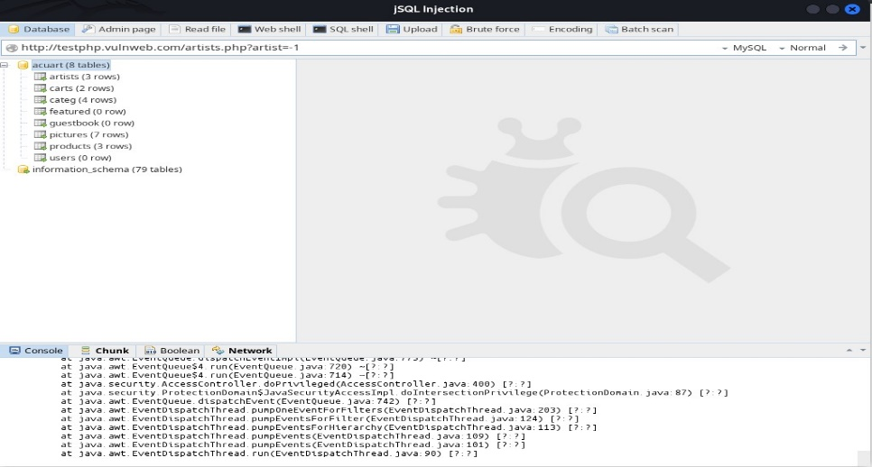
Exploiting SQLI Vulnerability(Continued)
After running the url in the tool it will show all the databases present in that website
2
3
5
55/100

Slide 56
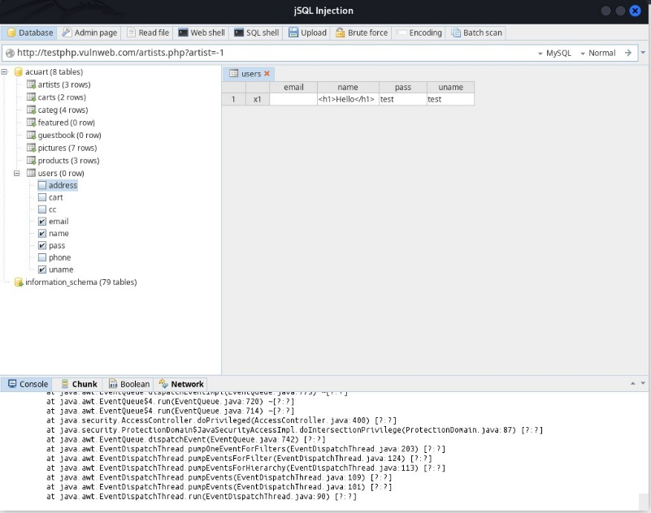
Exploiting SQLI Vulnerability(Continued)
Select the tables from the database that you want to see
2
3
5
56/100

Slide 57

Exploiting SQLI Vulnerability(Continued)
After selecting the tables right click on the database and click on load option to show all the data present in that table
2
3
5
57/100

Slide 58
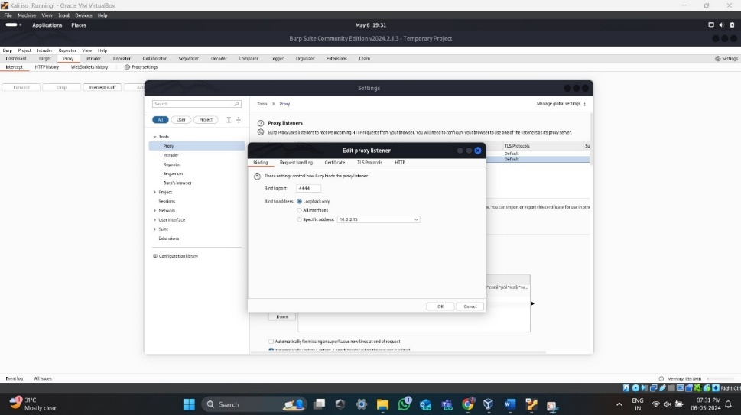
Exploiting SQLI Vulnerability(Continued)
SQL Injection attack using Burp Suite Tool
Setting up of network proxy and turning on network intercept
2
3
5
58/100

Slide 59
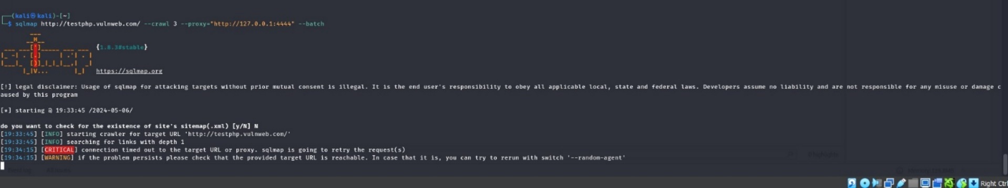
Exploiting SQLI Vulnerability(Continued)
Typing the command- Sqlmap -u http://testphp.vulnweb.com/--crawl 3 --proxy=”127.0.0.1:4444” --batch in kali linux terminal to capture the proxy
2
3
5
59/100

Slide 60
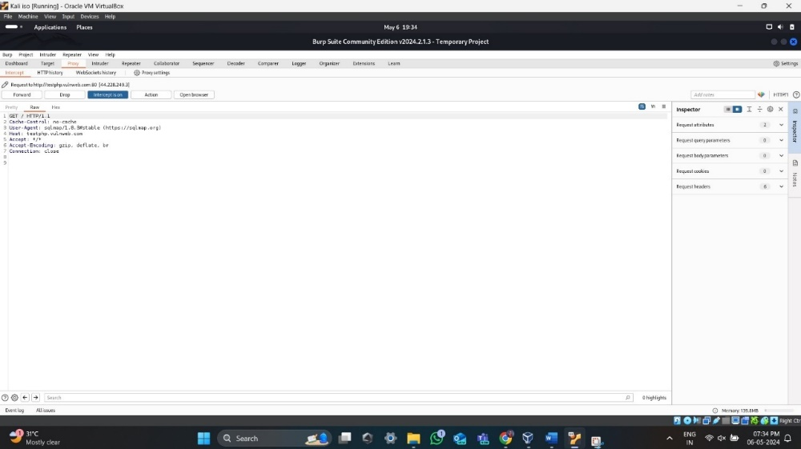
Exploiting SQLI Vulnerability(Continued)
The intercept is captured on Burp Suite and by pressing the forward button on burp suite we can fasten up the SQLI process
2
3
5
60/100

Slide 61
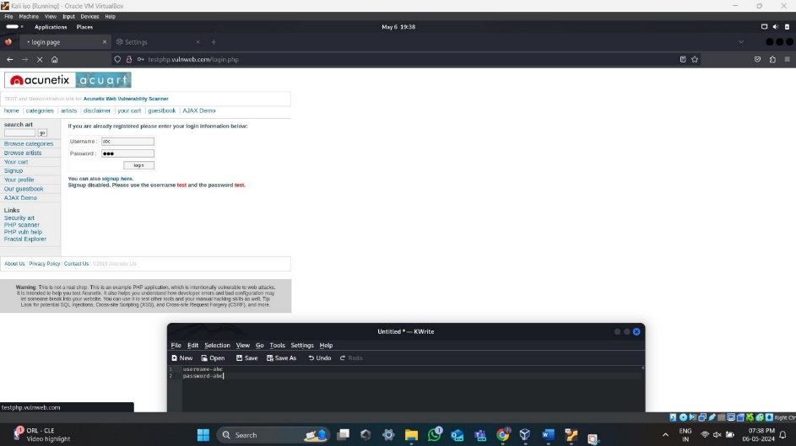
Exploiting SQLI Vulnerability(Continued)
SQL Injection attack using Burp Suite Tool
Go to Burp Suite and turn on the intercept button. Later go to the target website and give a random username and password and press enter.
2
3
5
61/100

Slide 62

Exploiting SQLI Vulnerability(Continued)
The request is captured by the burp suite. Once it is captured, save the request in any folder.
2
3
5
62/100

Slide 63

Exploiting SQLI Vulnerability(Continued)
Now run the command - Sqlmap -r abc --batch in kali linux terminal
2
3
5
63/100

Slide 64
SQL Injection Detection using ML Algorithms
Detection of SQL Injection using SVM Model
Review SVM-based intrusion detection studies, focusing on SQL injection methodologies, features, and performance metrics.
Identify and preprocess datasets for diverse SQL injection patterns.
Optimize and implement SVM architecture using a suitable ML framework.
Train SVM with cross-validation and validate on a separate dataset.
Use Accuracy, Precision, Recall, F1 score for assessment.
Fine-tune hyperparameters based on evaluation results.
2
3
Detection of SQL Injection using RF Model
Review RF-based intrusion detection studies, focusing on SQL injection methodologies, features, and performance metrics.
Identify and preprocess datasets for diverse SQL injection patterns.
Optimize and implement RF architecture using a suitable ML framework.
Train RF with cross-validation and validate on a separate dataset.
Use Accuracy, Precision, Recall, F1 score for assessment.
Fine-tune hyperparameters based on evaluation results.
5
64/100

Slide 65
SQL Injection Detection using ML Algorithms (Continued)
Detection of SQL Injection using Hybrid SVM-Random Forest Model
Review hybrid SVM-Random Forest models for intrusion detection and identify integration strategies.
Ensure dataset compatibility and adjust preprocessing for both models.
Design and implement architecture integrating SVM and Random Forest.
Train with balanced contributions, validate using cross-validation, and optimize hyperparameters.
Define metrics for assessment and compare against individual models.
2
3
5
65/100

Slide 66
Results
Results after applying ML Algorithms on Modified_SQL_Dataset
Table: Result table for Modified_SQL_Dataset
2
3
5
66/100

Slide 67
Results(Continued)
SVM-RF Hybrid Model Performance
Accuracy:99.1%
Precision: 99% and 100% for both classes
Recall:100% for both classes
Strengths:
Conclusion: Delivers robust performance across metrics, making it the preferred choice for reliable classification tasks.
2
Combines SVM and Random Forest for exceptional predictive capability
Minimizes false positives
Maximizes true positive identifications
High sensitivity in capturing all instances
3
5
67/100

Slide 68

Results(Continued)
Accuracy Bar Graph for Different Classifiers
2
3
5
68/100

Slide 69
Results(Continued)
Precision, Recall and F1-Score for class 0 Bar Graph for Different Classifiers
2
3
5
69/100

Slide 70
Results(Continued)
Precision, Recall and F1-Score for class 1 Bar Graph for Different Classifiers
2
3
5
70/100

Slide 71
Results(Continued)
Results after applying ML Algorithms on SQLI Dataset
Table: Result table for SQLI Dataset
2
3
5
71/100

Slide 72
Results(Continued)
SVM-RF Hybrid Model Performance Overview
Accuracy: 95.6%
Precision (Class 0):94%
Recall (Class 0): 100%
F1 Score (Class 0): 92%
Comparison to Alternative Models:
Conclusion:
Indicates proficiency in correctly identifying non-anomalous instances.
2
Excels in capturing all non-anomalous instances present in the dataset.
Demonstrates a harmonious balance between precision and recall, ensuring high accuracy in classifying non-anomalous data.
3
Outperforms counterparts in accuracy, precision, recall, and F1 score for non-anomalous instances.
The SVM-RF Hybrid Model is highly effective in accurately identifying normal data points, making it a standout choice for precision-centric classification tasks.
5
72/100

Slide 73
Results(Continued)
Accuracy Bar Graph for Different Classifiers
2
3
5
73/100

Slide 74
Results(Continued)
Precision, Recall and F1-Score for class 0 Bar Graph for Different Classifiers
2
3
5
74/100

Slide 75
Results(Continued)
Precision, Recall and F1-Score for class 1 Bar Graph for Different Classifiers
2
3
5
75/100

Slide 76
Results(Continued)
Results after applying ML Algorithms on Payload_Full_Dataset
Table :Result table for Payload_Full_ Dataset
2
3
5
76/100

Slide 77
Results(Continued)
SVM-RF Hybrid Model Performance Summary
Accuracy and Precision for Non-Anomalous Instances:
Accuracy: 99.9%
Precision: 100%
Demonstrates robustness in distinguishing normal patterns from anomalies.
Recall and F1 Score for Non-Anomalous Instances:
Recall: 100%
F1 Score: Approaching 100%
Ensures comprehensive coverage and accurate identification of normal patterns.
Accuracy and Precision for Anomalous Instances:
Accuracy: 99.9%
Precision: 100%
Shows capability in detecting outliers and abnormalities with precision.
Recall and F1 Score for Anomalous Instances:
Recall: 100%
F1 Score: 100%
Demonstrates comprehensive coverage and accurate identification of anomalies.
Comparison with Other Models:
Superior performance in accuracy, precision, recall, and F1 score for both anomalous and non-anomalous instances.
Highlights effectiveness in accurately distinguishing between normal and anomalous patterns.
2
3
5
77/100

Slide 78
Results(Continued)
Accuracy Bar Graph for Different Classifiers
2
3
5
78/100

Slide 79
Results(Continued)
Precision, Recall and F1-Score for class 0 Bar Graph for Different Classifiers
2
3
5
79/100

Slide 80
Results(Continued)
Precision, Recall and F1-Score for class 1 Bar Graph for Different Classifiers
2
3
5
80/100

Slide 81
Results(Continued)
Results after applying ML Algorithms on Clean_SQL_Dataset
2
Table: Result table for Clean_SQL_Dataset
3
5
81/100

Slide 82
Results(Continued)
Performance Superiority of SVM-RF Hybrid Model
Accuracy:
SVM-RF Hybrid Model: 97.1%
Random Forest Classifier: 91.8%
Support Vector Classifier (SVC): 91.8%
Demonstrates higher overall correctness in predictions compared to other models.
Precision and Recall Balance:
SVM-RF Hybrid Model achieves superior precision and recall rates for both classes (0 and 1).
Precision: 95% for class 0, 99% for class 1.
Recall: 99% for class 0, 95% for class 1.
Ensures lower rates of false positives and false negatives compared to other models.
Optimal F1-score:
F1-score of 97% for class 0 and 97% for class 1.
Achieves better harmonic mean between precision and recall.
Signifies balanced performance in identifying both positive and negative instances.
Conclusion:
SVM-RF Hybrid Model emerges as the preferred choice due to its superior accuracy, precision, recall, and F1-score.
Effectively classifies instances across both classes compared to SVC and Random Forest Classifier.
2
3
5
82/100

Slide 83
Results(Continued)
Accuracy Bar Graph for Different Classifiers
2
3
5
83/100

Slide 84
Results(Continued)
Precision Precision, Recall and F1-Score for class 0 Bar Graph for Different Classifiers
2
3
5
84/100

Slide 85
Results(Continued)
Precision, Recall and F1-Score for class 1 Bar Graph for Different Classifiers
2
3
5
85/100

Slide 86

SQL Injection Prevention
86/100

Slide 87

SQL Injection Prevention
Option 1 – Use of Prepared Statements
Code vulnerable to SQLi:
87/100

Slide 88


SQL Injection Prevention
Option 1 – Use of Prepared Statements
88/100

Slide 89

SQL Injection Prevention
Partial Options
89/100

Slide 90
SQL Injection Prevention
Additional Defenses
Least Privilege
The application should use the lowest possible level of privileges when accessing the database
Any unnecessary default functionality in the database should be removed or disabled
Ensure CIS benchmark for the database in use is applied
All vendor-issued security patches should be applied in a timely fashion
90/100

Slide 91
Conclusion
Enhance SQL injection (SQLi) detection using machine learning models (SVM, Random Forest, Hybrid)
Comparative efficacy of SVM, Random Forest, and Hybrid models for SQLi detection
Preprocessing phase: rigorous cleansing and transformation of datasets
Employed mean/median imputation, data cleaning, and feature engineering
Hyperparameter tuning: optimized SVM, Random Forest, and Hybrid models
Model evaluation: used metrics such as accuracy, precision, recall, and F1-score
Conducted statistical significance testing and feature importance analysis
SVM, Random Forest, and Hybrid models showed promising performance
91/100

Slide 92
Conclusion(continued)
The SVM-RF Hybrid model emerged as the most effective, demonstrating superior efficacy and resilience
Robust SQLi detection methodologies are crucial for cybersecurity
Advanced ML models significantly enhance the resilience of digital ecosystems against cyber threats and SQLi attacks
92/100

Slide 93
Future Scope
Future research should refine and optimize existing models and explore new machine learning algorithms.
Innovative feature engineering techniques are needed to enhance detection accuracy and efficiency.
Collaboration with industry stakeholders and cybersecurity experts is crucial for real-world validation and implementation.
Continuous vigilance and adaptation to emerging threats are essential for maintaining cybersecurity resilience.
This study provides a foundational basis for advancing SQLi detection methodologies and strengthening cybersecurity defenses against cyber threats.
93/100

Slide 94
Scope
Security Analysts and Researchers
Gain comprehensive insights for deeper understanding and development of advanced detection and mitigation strategies.
Web Developers and Programmers
Implement robust security measures and coding practices to mitigate SQL injection vulnerabilities, enhancing the security of web applications.
Database Administrators (DBAs)
Implement proactive security measures such as access controls and parameterized queries to prevent SQL injection attacks and ensure data integrity and confidentiality.
Cybersecurity Consultants:
Provide effective advisory services to clients, helping them identify and address SQL injection vulnerabilities through security assessments and incident response planning.
94/100

Slide 95
Scope (continued)
Educators and Trainers:
Prepare cybersecurity professionals by incorporating practical knowledge and skills for detecting and preventing SQL injection vulnerabilities into cybersecurity education curricula.
Software Security Engineers:
Develop robust security frameworks and protocols to detect and mitigate SQL injection vulnerabilities, improving overall software security.
Government Agencies:
Utilize research outcomes to inform policy development and industry regulations aimed at mitigating SQL injection vulnerabilities and protecting critical infrastructure from cyberattacks.
End Users and Consumers:
Benefit from improved security measures recommended by the research, leading to enhanced user trust and confidence in online transactions and interactions.
95/100

Slide 96
Paper to be communicated
Prepared a paper titled “Enhancing SQL Injection Detection A Comparative Study of SVM, Random Forest, and Hybrid Models” to be submitted to a journal.
96/100

Slide 97
References
Gandhi, et al., "Unveiling the Masters of Deception: Algorithmic Approaches for SQL Injection Defense," IEEE Transactions on Cybersecurity, vol. 11, no. 4, pp. 789-803, 2023.
Wang, et al., "Beyond Accuracy: Exploring Robustness in Machine Learning for SQL Injection Defense," IEEE Transactions on Information Forensics and Security, vol. 15, no. 2, pp. 456-470, 2022.
Zhang, et al., "Fine-Tuned Gaussian SVM for PHP Code Vulnerability Detection," IEEE Transactions on Dependable and Secure Computing, vol. 20, no. 1, pp. 234-247, 2022.
Alawe, et al., "Hybrid Horizons: CNN-BiLSTM Fusion for Enhanced SQL Injection Detection," IEEE Transactions on Neural Networks and Learning Systems, vol. 28, no. 5, pp. 1123-1136, 2023.
Gandhi, et al., "Web Warriors: Machine Learning Applications in Web Security," IEEE Security & Privacy, vol. 19, no. 3, pp. 67-79, 2023.
2
3
5
97/100

Slide 98
References (continued)
Li, et al., "Android Armor: Machine Learning Approaches to SQL Injection Detection in Android Applications," IEEE Transactions on Mobile Computing, vol. 22, no. 4, pp. 890-905, 2023.
Akhil, et al., "Context Counts: Tailoring Machine Learning for Context-Driven SQL Injection Defense," IEEE Transactions on Knowledge and Data Engineering, vol. 25, no. 6, pp. 1345-1358, 2022.
Jha, et al., "Beyond Detection: Proactive Machine Learning Strategies for SQL Injection Prevention," IEEE Transactions on Dependable and Secure Computing, vol. 21, no. 3, pp. 567-581, 2023.
Wang, et al., "The Evolving Landscape: Continuous Adaptation of Machine Learning Models for SQL Injection Defense," IEEE Transactions on Emerging Topics in Computing, vol. 11, no. 1, pp. 234-248, 2022.
Akhil, et al., "The Human-Machine Alliance: Leveraging Expertise for Effective Cybersecurity," IEEE Security & Privacy, vol. 20, no. 4, pp. 112-125, 2022.
2
3
5
98/100

Slide 99
References (continued)
Sajid Ali. (n.d.). SQL Injection Dataset. Retrieved from Kaggle: https://www.kaggle.com/datasets/sajid576/sql-injection-dataset
Gambleryu. (n.d.). Biggest SQL Injection Dataset. Retrieved from Kaggle: https://www.kaggle.com/datasets/gambleryu/biggest-sql-injection-dataset
Henil Vedant. (n.d.). SQL Injection Payload. Retrieved from Kaggle: https://www.kaggle.com/datasets/henilvedant/sqlinjection-payload
Syed Saqlain Hussain. (n.d.). SQL Injection Dataset. Retrieved from Kaggle: https://www.kaggle.com/datasets/syedsaqlainhussain/sql-injection-dataset
OWASP. (n.d.). OWASP Mutillidae II. Retrieved from OWASP: https://owasp.org/www-project-mutillidae-ii/
Acunetix. (n.d.). Test Site for SQL Injection. Retrieved from Test Site for SQL Injection: http://testphp.vulnweb.com/
2
3
5
99/100

Slide 100
Thank You
100/100

